Slide 1
E-Buddy For Rescued Child Labour
Submitted in the partial fulfillment for the award of the degree of
BACHELOR OF ENGINEERING
IN
ARTIFICIAL INTELLIGENCE AND MACHINE LEARNING
Submitted by:
Avanish Rai – 20BCS8812
Chirag Karnwal – 20BCS6886
Under the Supervision of:
Mrs. Lata Gupta
Department of AIT-CSE
DISCOVER . LEARN . EMPOWER

Slide 2
Outline
Introduction to Project
Problem Formulation
Objectives of the work
Methodology used
Results and Outputs
Conclusion
Future Scope
References

Slide 3
Introduction to Project
Child labor is the term used to describe the employment of children in any work that harms their physical and mental development, robs them of their youth, and strips them of their potential and dignity. This practice is common in many nations and seriously harms children's health, education, and general well-being. Child labor can have significant, long-lasting impacts.
Children who work long hours in hazardous or toxic environments run the risk of suffering from physical injuries, illnesses, or even passing away. Additionally, they do not take advantage of the chances that come with education, which limits their future prospects and keeps them trapped in a cycle of poverty.
These organizations ought to offer children the educational, psychological, and medical assistance they need to recover from their experiences and start a new.
In addition to helping children live happy, productive lives, education and skill development can help end the cycle of poverty. Additionally, these initiatives can stimulate community participation and increase awareness of the risks associated with child labor.

Slide 4
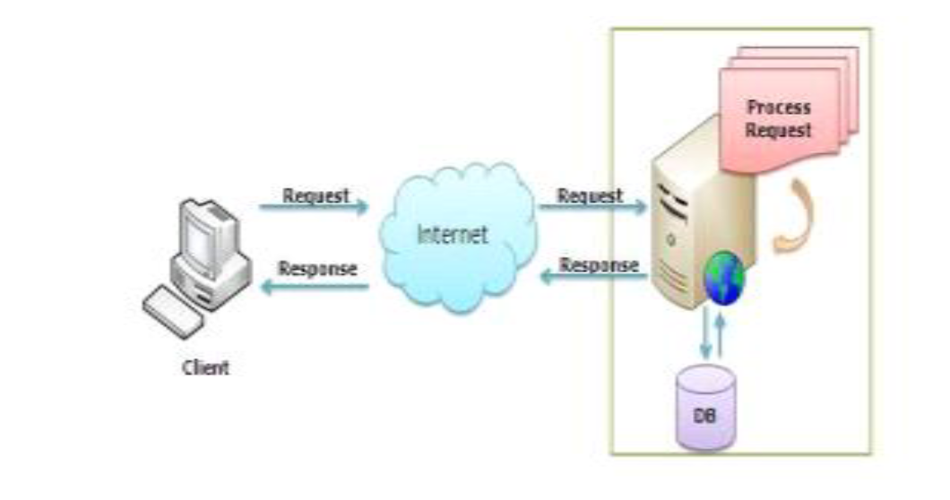
Additionally, such programs can raise awareness about the dangers of child labor and encourage communities to work.

Slide 5
Problem Formulation
Problem Statement - The issue of child labor is a persistent and grave concern that violates the basic rights of children and deprives them of their childhood, education, and physical and emotional well-being. Many organizations and initiatives have made strides in rescuing child laborers from exploitative environments, but the successful reintegration and rehabilitation of these rescued children into society remains a complex challenge. These children often lack proper guidance, education, and emotional support, hindering their ability to transition effectively into a normal life.
To address this problem, there is a need to develop an innovative solution: "E-Buddy for Rescued Child Labour." This digital platform aims to provide personalized support and resources for the rehabilitation and empowerment of rescued child laborers.

Slide 6
Provide Personalized Guidance: Offer personalized mentoring and counseling services to address the individual needs and challenges faced by each rescued child laborer.
Facilitate Educational Recovery: Deliver tailored educational content and resources to help bridge the educational gaps and enable children to catch up on missed learning opportunities.
Offer Emotional Support: Provide a safe and supportive digital space where children can connect with counselors and peer groups to address emotional trauma and foster resilience.
Skills Training: Offer access to skill development courses and vocational training, empowering the children to acquire valuable skills for their future.
Notes:
Data Collection and Preparation: The next step is to collect and prepare the data that will be used to train the chatbot. The data can be collected from various sources, such as college websites, student forums, and other online resources. The data must be cleaned, pre-processed, and labeled appropriately.
Model Selection and Training: The third step is to select an appropriate AI model and train it using the prepared data. Some popular AI models for chatbots include deep learning models such as Recurrent Neural Networks (RNN), Long Short-Term Memory (LSTM), and Transformer models such as GPT-3.
Integration with Chat Platform: After the model is trained, it needs to be integrated with a chat platform that will allow users to interact with the chatbot. Some popular chat platforms include Facebook Messenger, Slack, and WhatsApp.
Testing and Evaluation: The next step is to test the chatbot and evaluate its performance. This involves using various test cases to ensure that the chatbot can accurately answer questions related to college admissions, courses, fees, and other related information.
Deployment: Once the chatbot has been tested and evaluated, it can be deployed to the chosen chat platform for use by college applicants and other users.
Continuous Improvement: Finally, the chatbot must be continuously improved based on user feedback and additional data to ensure that it stays up-to-date and relevant.

Slide 7
Millions of children worldwide suffer from the effects of child labor, which robs them of their childhood and potential. Numerous studies have been carried out over the years to comprehend the state of the field's research and the difficulties faced by rescued child laborers.
Children who have a mentor can gain social skills, self-confidence, and connections that will help them in the future. The use of technology to support initiatives for child laborers who have been rescued has also drawn a lot of attention in the literature. Children can access educational and mental health resources no matter where they are thanks to technology, such as online courses and virtual counseling sessions.
The challenges that the rescued child laborers face are highlighted in the existing literature, as are the benefits of mentorship in their recovery and reintegration, and the use of technology to support such initiatives. This study offers insightful information about the experiences of these kids, which can help with the creation of programs and regulations that will support their recovery and reintegration.
Notes:
Data Collection and Preparation: The next step is to collect and prepare the data that will be used to train the chatbot. The data can be collected from various sources, such as college websites, student forums, and other online resources. The data must be cleaned, pre-processed, and labeled appropriately.
Model Selection and Training: The third step is to select an appropriate AI model and train it using the prepared data. Some popular AI models for chatbots include deep learning models such as Recurrent Neural Networks (RNN), Long Short-Term Memory (LSTM), and Transformer models such as GPT-3.
Integration with Chat Platform: After the model is trained, it needs to be integrated with a chat platform that will allow users to interact with the chatbot. Some popular chat platforms include Facebook Messenger, Slack, and WhatsApp.
Testing and Evaluation: The next step is to test the chatbot and evaluate its performance. This involves using various test cases to ensure that the chatbot can accurately answer questions related to college admissions, courses, fees, and other related information.
Deployment: Once the chatbot has been tested and evaluated, it can be deployed to the chosen chat platform for use by college applicants and other users.
Continuous Improvement: Finally, the chatbot must be continuously improved based on user feedback and additional data to ensure that it stays up-to-date and relevant.

Slide 8
Objectives of the Work
Main objective is to facilitate the rehabilitation and well-being of children who have been rescued from child labor situations.
The focus remains on creating a better future for these vulnerable children, allowing them to grow and thrive in a safe and nurturing environment.
Moreover, the project emphasizes the pivotal role of education in empowering these children to break free from the cycle of poverty and exploitation.

Slide 9
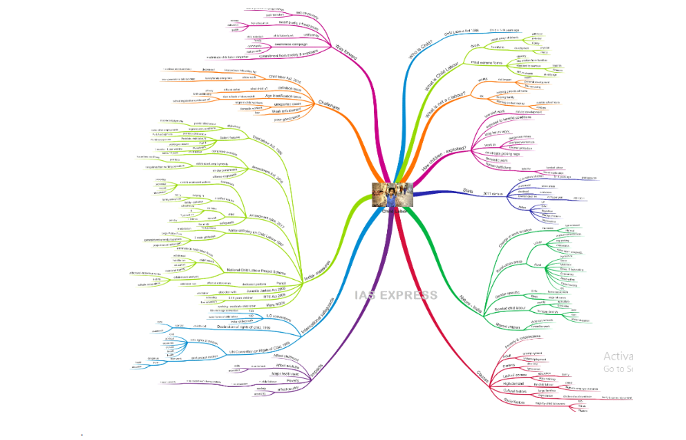
Methodology used

Slide 10
Methodology used
In India, the prevalence of child labor has significantly decreased over the past two decades, both in terms of its prevalence and rates of workforce participation. According to data from the National Sample Survey, there were slightly more than nine million (9.07 million) children working in India in 2004–05 as opposed to twenty-one and a half million (21.55 million) in 1983. The number of children working has dramatically decreased by 12.48 million during this time. The child labor force has decreased significantly more for boys than for girls. From 1983 to 2004-05, there was a corresponding decline in the number of boys and girls working, from 12.06 to 4.76 million and 9.49 to 4.31 million, respectively.

Slide 11
Methodology used
The Major National Legislative Developments include the following:-
The factories Act of 1948, which prohibits the employment of young children and specifies the working hours of minors (M.C. Mehta v. State of Tamil Nadu), is a significant Act.(Democratic Rights Vs. Union of India) The Employment of Children Act of 1938 forbids the employment of children under the age of 15 in any occupation related to the transportation of passengers or goods. The purpose of the Children (pledging of Labour) Act of 1933 is to end the evil of pledging the labor of a child under the age of 15.

Slide 12
Methodology used..
The Child Labour ( prohibition and regulation ) Act of 1986 and The Apprentices Act of 1961 treats a person up to the age of 14 years of the child. This Act has made necessary amendments in other Acts to bring the uniformity in age.

Slide 13
Results and Outputs
Numerous policy recommendations at the national and international levels call for mandatory education and the outlawing of child labor due to the harmful effects of child labor.
The paper calls for a holistic approach to address the problem of child labour and attempts to provide model of child advocacy network that is visible and accessible to a child in distress.

Slide 14
The three critical components of such an approach is:
To provide support to the distressed families to remove their dependency on child labour.
An overhauling of the education system to make it respond to the needs of the economy.
An effective child advocacy system that is integrated with the local governance structure.
These are three components are not to supplant but to supplement the existing measures. With an integrated approach we intend to develop a website(web application) that implements computerized tracking system forvictims under child labour using Geographical Information Software.

Slide 15
Conclusion
To conclude, Several important findings are highlighted in the study on the effect of initiatives like E-buddy on rescued child laborers.First off, it has been noted that these programs are essential in helping to support and direct the rescued child laborers. This aids in their reintegration into society and helps them understand the physical and psychological trauma they have endured.
Secondly, the research has demonstrated that these initiatives can significantly enhance the educational and employment outcomes of rescued child laborers. This can ensure that these kids have a better future and help end the cycle of exploitation and poverty.
The need for additional study and intervention in this field should also be noted. This will make it easier to comprehend the difficulties faced by rescued child laborers and create programs to support them that are more successful. In order to ensure the best outcomes for these vulnerable kids, it is critical to keep funding research and intervention in this field. Programs like E-buddy are crucial in supporting rescued child laborers.
.

Slide 16
References
[1] Operational Indicators of Trafficking in Human Beings 2009 ILO/SAP-FL Lists of the indicators of Trafficking in Human
Beings 2009 ILO/SAP-FLEradication of forced labour - General Survey concerning the Forced Labour Convention, 1930
(No. 29), and the Abolition of Forced Labour Convention, 1957 (No. 105) - ILO 2007Forced Labour:
[2] Definition, Indicators and Measurement 2004 - ILO Stopping Forced Labour 2001 - ILOAgbu,Osita(2009).
[3] Children and Youth in the Labour Process in Africa. African Books Collective. ISBN 978-2-86978-251-8.Forster , John (2006)
[1872–1874].
[4] The Life of Charles Dickens. London: Diderot Publishing. ISBN978-90-77932-03-2. Archived from the original on 21
September 2015.
[5] Retrieved 2 July 2015 wikie .Lieten, Kristoffel; Meerkerk, Elise van Nederveen (2011).
[6] Child Labour's Global Past, 1650-2000. Peter Lang. ISBN 978-3-0343-0517-4.Honeyman, Katrina (2016).
[7] Childhood and Child Labour in Industrial England Diversity and Agency, 1750–1914. Routledge. ISBN 978-1-317-16792-

